Slide 1

National Education Society ® JNN College of Engineering Dept. of Information and Engineering
Project Seminar on
“Image Captioning Using A.I”
Guided by :
Mrs. Rashmi R_{B.E., M.Tech,}
Associate Professor,
Dept. of IS&E
Presented by: Batch 11
Name | USN
Aakash S Ganiger | 4JN22IS004
Adarsh B K | 4JN22IS009
Adithya S S | 4JN22IS011
Akash A Navale | 4JN22IS016

Slide 2
Introduction
Image Captioning Using A.I is an interdisciplinary field combining computer vision and natural language processing (NLP) to generate textual descriptions for images. It involves understanding the visual content in an image, extracting relevant features, and translating them into coherent and meaningful captions.
This process mimics human cognition, where one interprets an image and articulates it in natural language.
Advancements in deep learning and the use of neural network architectures, such as Convolutional Neural Networks (CNNs) for feature extraction and Recurrent Neural Networks (RNNs) or Transformers for language modeling, have made significant strides in automating this complex task.
This project aims to create a system that effectively interprets image data and provides accurate captions, enabling numerous applications in accessibility, content management, and human-computer interaction.

Slide 3
Problem statement:
“Design and implement an automated system that takes an image as input and generates an accurate, contextually relevant caption. This involves the use of pre-trained CNNs for visual feature extraction and LSTMs to generate meaningful language descriptions based on those features.”
Objectives:
To collect and preprocess a diverse dataset of images representing various real-world scenarios.
To train machine learning models capable of generating accurate and context-aware captions for images by analyzing visual elements and their relationships.
To develop a user-friendly interface that enables users to upload images and receive descriptive captions, enhancing accessibility and user interaction.

Slide 4
Literature Survey on Paper 1
Image Captioning with Deep Learning Techniques
Authors: Kelvin Xu, Jimmy Lei Ba, Ryan Kiros
Summary: This study introduces image captioning using an attention mechanism in a neural network model. The attention-based system dynamically focuses on specific parts of the image while generating captions, improving contextual relevance and overall description quality.
Advantages:
Dynamic attention improves caption relevance.
Handles complex and diverse image content effectively.
Enhances contextual understanding through attention.
Disadvantages:
Training requires high computational power.
Sensitive to variations in datasets.
Struggles with rare or unseen image types.

Slide 5
Literature Survey on Paper 2
Show and Tell: A Neural Image Caption Generator
Authors: Oriol Vinyals, Alexander Toshev, Samy Bengio, Dumitru Erhan
Summary: This paper proposes an encoder-decoder framework for image captioning using a CNN-LSTM architecture. The CNN extracts image features, and the LSTM generates captions, achieving state-of-the-art performance at the time.
Advantages:
Simplifies image-to-text generation with encoder-decoder architecture.
Effective for standard datasets like MS COCO and Flickr.
Enables end-to-end training for feature extraction and captioning.
Disadvantages:
Limited generalization to unseen data.
Heavily reliant on dataset quality.
Generates generic captions in complex scenarios.

Slide 6
Literature Survey on Paper 3
Image Captioning with Transformers
Authors: Ashish Vaswani, Noam Shazeer, Niki Parmar
Summary: This research applies Transformer models to image captioning, utilizing self-attention mechanisms for better sequence understanding. The architecture demonstrates superior performance over RNN-based models in terms of caption fluency and relevance.
Advantages:
Captures long-range dependencies effectively.
Superior to RNNs in caption fluency and coherence.
Scales well with large datasets.
Disadvantages:
High computational and memory requirements.
Requires extensive fine-tuning for specific applications.
Challenging to interpret due to model complexity.

Slide 7
Literature Survey on Paper 4
Visual Attention Models for Image Captioning
Authors: Jiebo Luo, Kyunghyun Cho
Summary: This study explores visual attention models for improving image captioning accuracy. By incorporating spatial and semantic attention, the model aligns generated captions closely with key image regions.
Advantages:
Aligns captions with important visual regions.
Improves semantic accuracy and specificity.
Works well with complex and cluttered images.
Disadvantages:
Computationally intensive due to attention mechanisms.
Sensitive to noisy or inconsistent datasets.
Requires extensive training to optimize performance.

Slide 8
Literature Survey on Paper 5
Image Captioning with Reinforcement Learning
Authors: Junhua Mao, Wei Xu
Summary: This research integrates reinforcement learning into image captioning to optimize caption generation based on evaluation metrics like BLEU and METEOR. The approach enhances caption relevance and diversity.
Advantages:
Optimizes captions for better metric performance.
Enhances diversity in generated descriptions.
Adapts well to varying evaluation criteria.
Disadvantages:
Requires careful reward design for effective training.
Computationally expensive due to iterative learning.
Can lead to overfitting specific metrics rather than general quality.

Slide 9
Data Collections and Other Details
Dataset Used:
Flickr8k Dataset and MS COCO.
Key Features:
Contains 8,000 images, each annotated with descriptive captions.
Designed for tasks like image captioning and visual description generation.
Preprocessing Steps:
Image Resizing: Images resized to 224x224 pixels for compatibility with CNN models.
Normalization: Pixel values scaled to the range of 0-1.
Tokenization: Captions tokenized and padded to a fixed length to ensure uniformity.
Vocabulary: Built from frequently occurring words in the dataset.
Tools Used:
TensorFlow, Keras, NumPy, and NLTK for data preparation and processing.

Slide 10
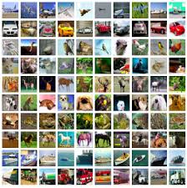
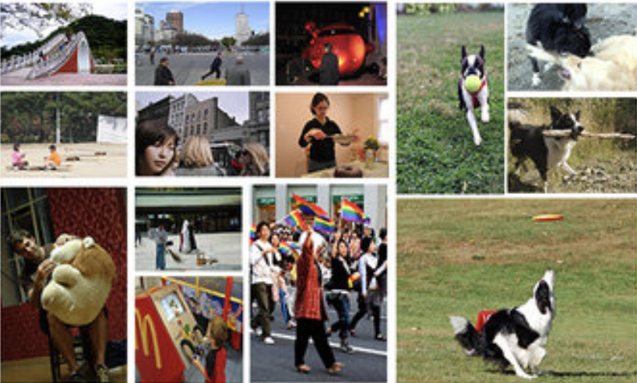
Sample set of images from Flickr30k dataset
Sample set of images from MS COCO dataset

Slide 11
System Design and Implementation
Model Architecture:
CNN (Convolutional Neural Network): Extracts image features.
Development Environment:
Implemented on Google Colab.
Utilized TensorFlow and Keras libraries for seamless execution.
Dataset Preprocessing:
Standardized image dimensions.
Applied data augmentation (rotation, flipping, scaling) to enhance diversity and generalization.
System Workflow:
Preprocessing: Normalize and augment image data.
Feature Extraction: Use CNN for deep feature extraction.
Caption Generation: Employ attention-enabled RNN for coherent descriptions.

Slide 12
Convolution Neural Network (VGG16)
Role:
Extract visual features from images to generate meaningful captions.
Feature Extraction:
Captures key visual details like edges, textures, and objects within the image.
Architecture:
Convolutional layers: Identify critical features from input images.
Pooling layers: Reduce dimensionality while preserving essential information.
Fully connected layers: Convert extracted features into vector representations for the RNN decoder.
Training Approach:
VGG16, pre-trained on ImageNet, is fine-tuned for the specific dataset to improve captioning accuracy.
Performance:
Integrates with attention mechanisms to focus on relevant image regions, generating coherent and contextually accurate captions.

Slide 13
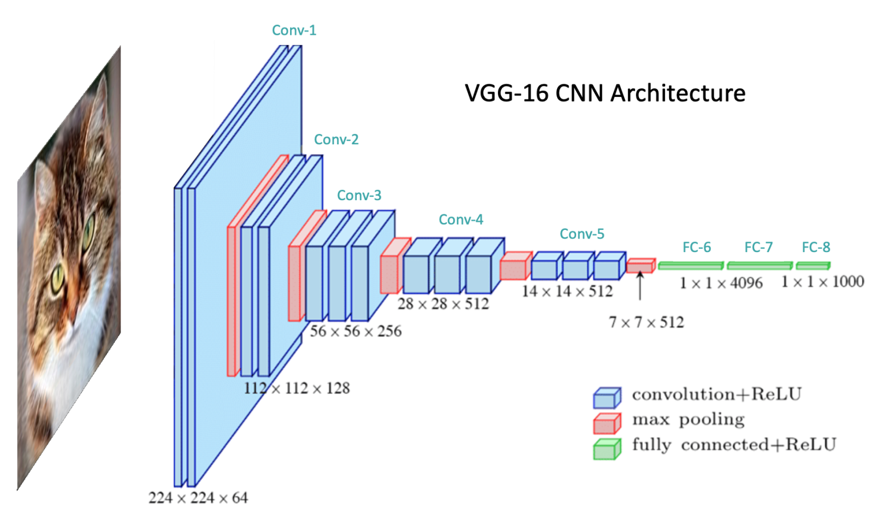
Block diagram of VGG-16 CNN Architecture

Slide 14
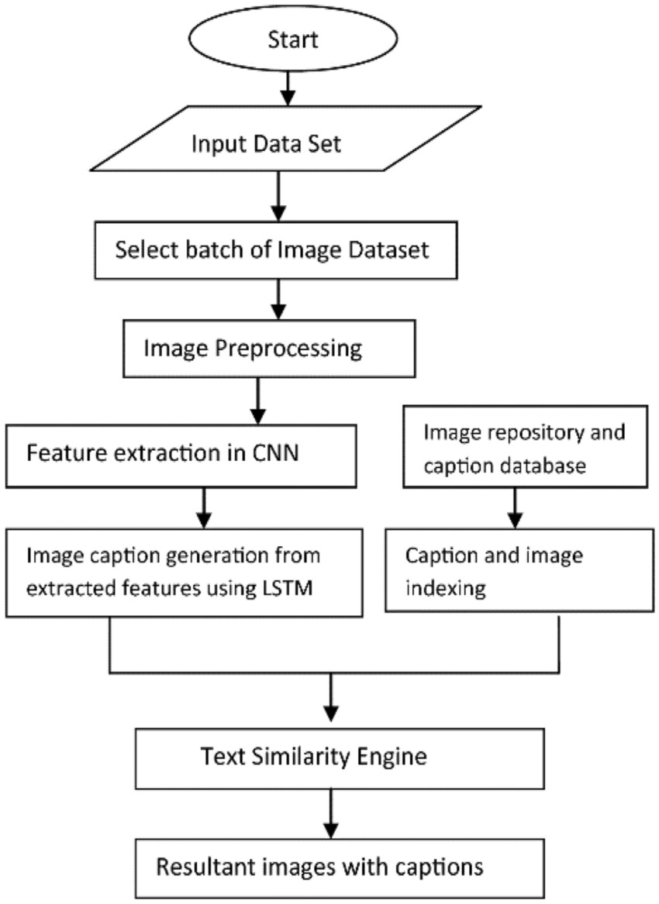
Flowchart:

Slide 15
Libraries Used
NumPy: For numerical operations and efficient array processing.
Keras: For building and training deep learning models.
TensorFlow: For handling backend deep learning computations and frameworks.
NLT - Natural Language Toolkit: For natural language processing tasks, such as tokenizing captions and embedding preparation.
Gradio: To create interactive web interfaces for machine learning models, as it provides a user-friendly platform for uploading images and generating captions in real-time.

Slide 16
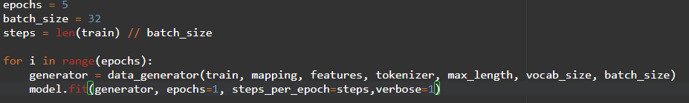
Backend Images
Code snippet for training the model

Slide 17
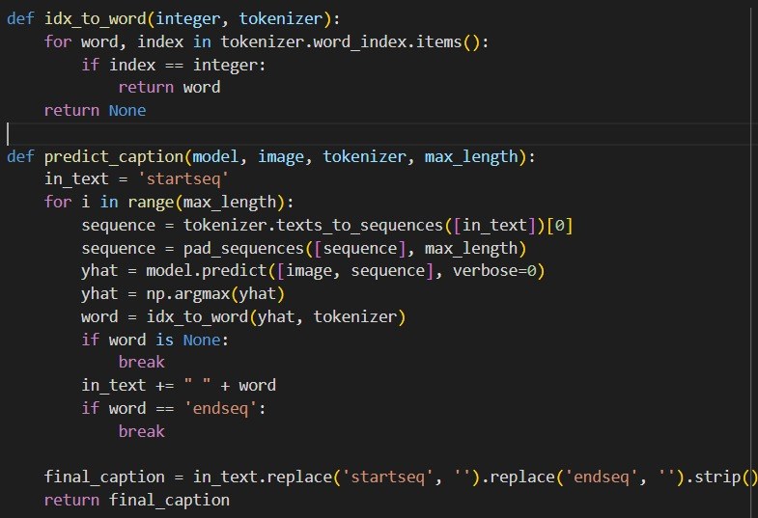
Code snippet for caption prediction

Slide 18
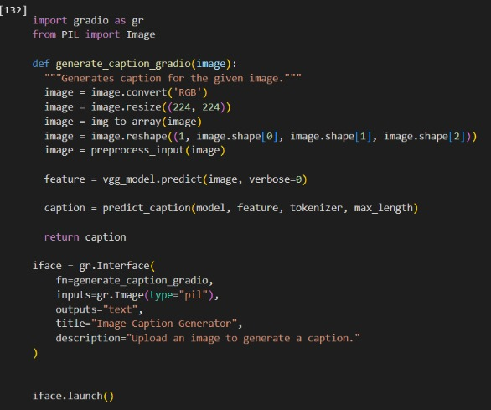
Code snippet of frontend

Slide 19
Front-end Implementation
Frontend Development Using Gradio
The project's frontend was developed using Gradio, a Python library for creating interactive interfaces. Gradio allowed seamless integration of the machine-learning model into a web-based application, providing a simple and intuitive interface.
Key functionalities include:
Image Upload: Users can upload any image for caption generation.
Real-Time Results: Captions are generated instantly, displaying meaningful and contextually relevant descriptions.
Dynamic Interaction: Users receive accurate and detailed captions, enhancing understanding of the visual content.
Gradio Interface: Gradio’s flexibility and simplicity make it ideal for this project, enabling an accessible, interactive system for both technical and non-technical users.

Slide 20
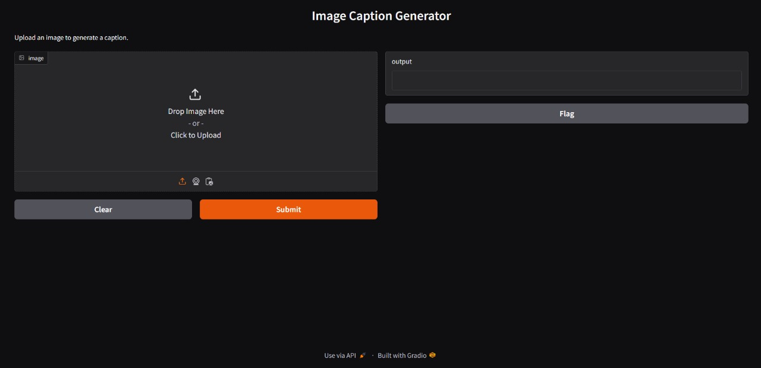
Frontend – Gradio interface

Slide 21
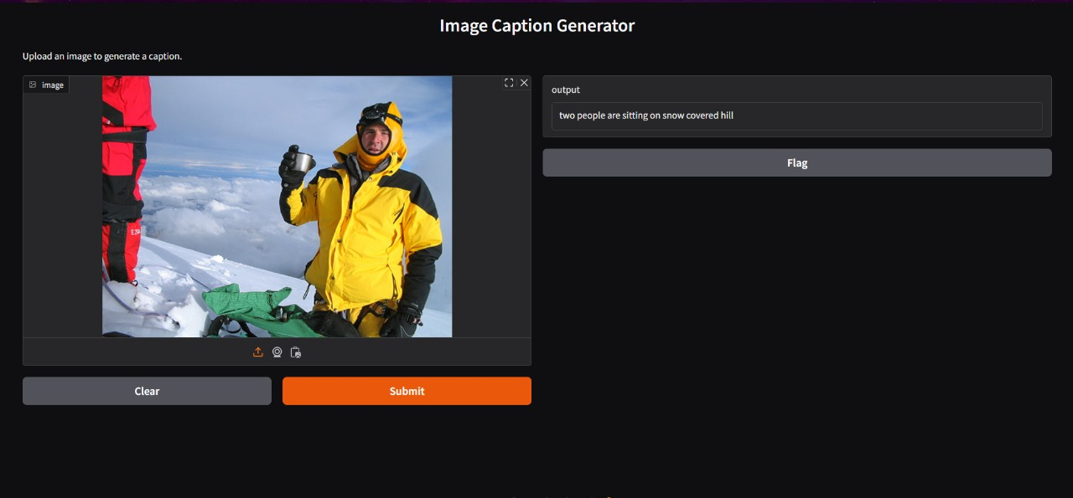
Results : Caption Generated for the below image: “two people on snow covered”

Slide 22
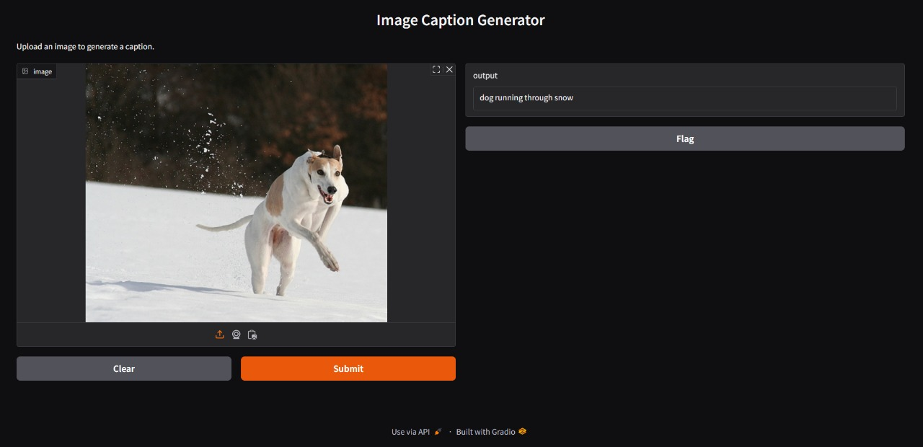
Results : Caption Generated for the below image: “dog running through snow”

Slide 23
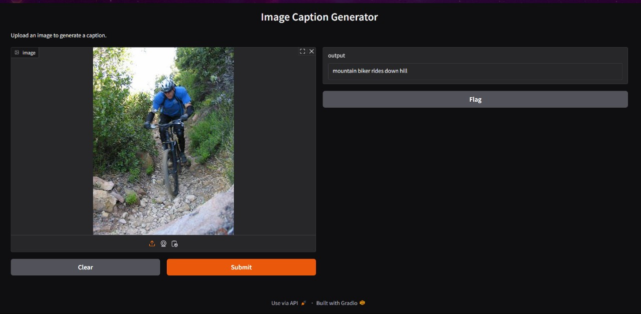
Results : Caption Generated for the below image: “mountain biker rides down hill”

Slide 24
Conclusion
Bridging Visual and Textual Understanding:
The project uses deep learning to connect visual and textual data through image captioning.
Model Utilization:
CNNs are employed for feature extraction, while LSTMs handle caption generation, ensuring meaningful and contextually relevant captions.
Cost-Effective Solution:
Provides an efficient and affordable method for automating visual content descriptions, benefiting fields like accessibility, content creation, and multimedia management.
Future Improvements:
Expand the dataset for greater diversity.
Explore advanced architectures, such as transformer-based models.
Integrate the system into user-friendly platforms like mobile or web applications.
Significance:
Establishes a foundation for AI-driven image understanding, with potential to transform visual data interpretation and utilization across various domains.

Slide 25
REFERENCES
[1]. Xu, K., Ba, J. L., Kiros, R., Cho, K., Courville, A., Salakhutdinov, R., Zemel, R., & Bengio, Y. (2015). Show, Attend and Tell: Neural Image Caption Generation with Visual Attention. Proceedings of the International Conference on Machine Learning (ICML), 2048–2057.
[2]. Vinyals, O., Toshev, A., Bengio, S., & Erhan, D. (2015). Show and Tell: A Neural Image Caption Generator. Proceedings of the IEEE Conference on Computer Vision and Pattern Recognition (CVPR), 3156–3164.
[3]. Vaswani, A., Shazeer, N., Parmar, N., Uszkoreit, J., Jones, L., Gomez, A. N., Kaiser, Ł., & Polosukhin, I. (2017). Attention Is All You Need. Advances in Neural Information Processing Systems (NeurIPS), 30, 5998–6008.
[4.] Lu, J., Xiong, C., Parikh, D., & Socher, R. (2017). Knowing When to Look: Adaptive Attention for Visual Captioning. Proceedings of the IEEE Conference on Computer Vision and Pattern Recognition (CVPR), 375–383.
[5]. Mao, J., Xu, W., Yang, Y., Wang, J., Huang, Z., & Yuille, A. L. (2015). Deep Captioning with Multimodal Recurrent Neural Networks (m-RNN). International Conference on Learning Representations (ICLR).

Slide 26
Thank You

